Slide 1
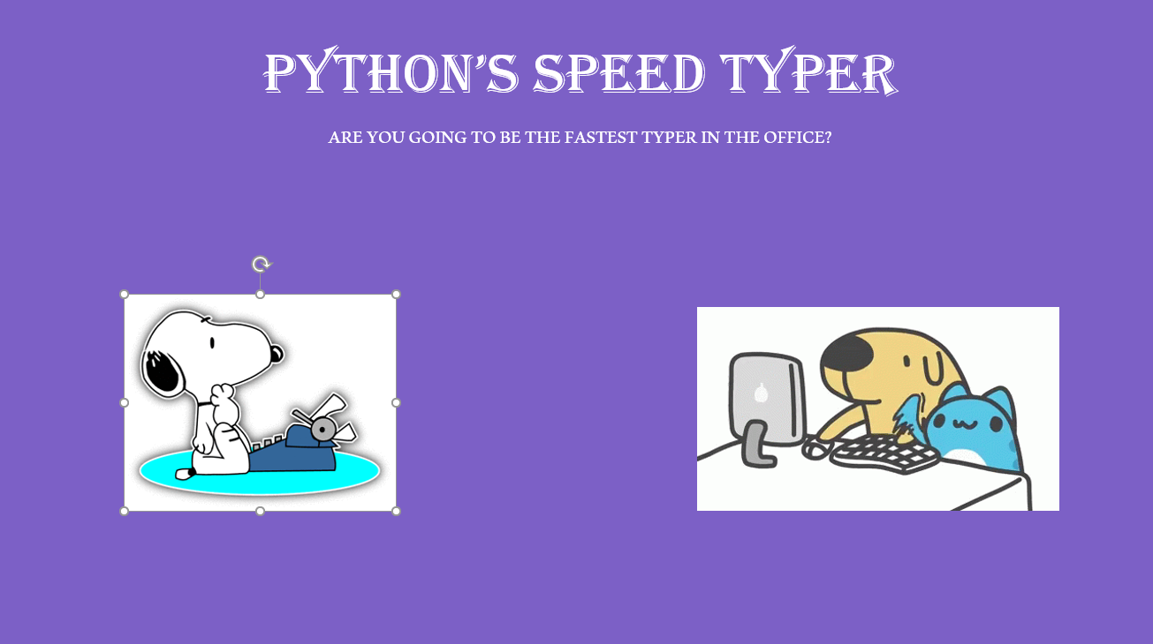
Python’s Speed Typer
Coder: Michael von Kutzleben
Original code:https://techvidvan.com/tutorials/project-in-python-typing-speed-test/

